Slide 1
MashZone Dynamic data sources
November 2010 Stephan Freudl

Slide 2
Motivation
Even in Enterprise Edition MashZone can read 10,000 lines per data source, only. (Similar limitations after join/union operators.)
Rationale for this is MashZone’s intention:
MashZone is about dashboarding based on values aggregated previously
Number crunching should be delegated to back ends
This slides explain how to interact with back ends. Results of user interactions will be used to re-query a database.
Notes:
2

Slide 3
Overview
Employee
Name Dep. No
Department
Name Dep. No
Example is based on Oracle XE sample schema HR. ARIS Community explains how to activate it and hook up MashZone against. Today two tables are of interest
Table Employees which lists employees’ names and a department number (foreign key) each employee is assigned to.
Table Departments which consists of a unique department number (primary key) and departments names.
Assuming there are many employees this sample used the department as a filter.
List departments
Use department’s name/number to query for employees assigned to it
List employees filtered by department number Filtering is done outside MashZone, i.e. it is delegated to the database.
Notes:
3

Slide 4
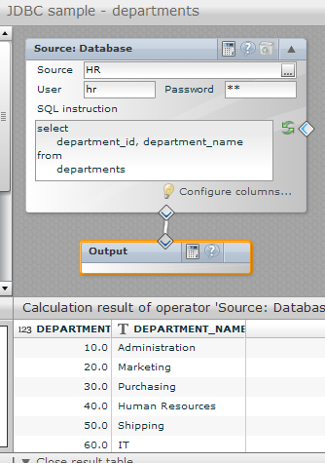
List departments
In the first step create an empty MashApp and a data feed to list all departments.
select department_id, department_name from departments

Slide 5
List departments
Based on the two column data feed bind it to a selection box.
The box contains in fact two columns
Visible one with names
Invisible column containing the department number
Therefore after a box entry is selected two attributes are returned.

Slide 6
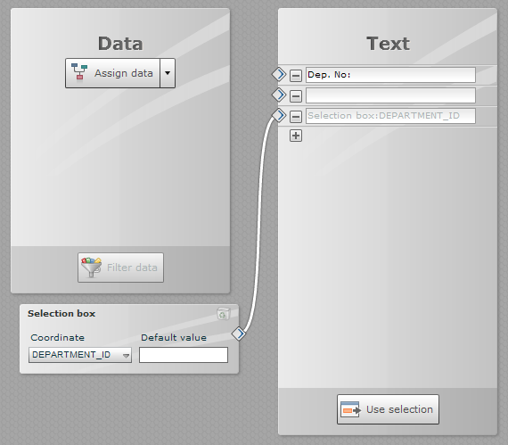
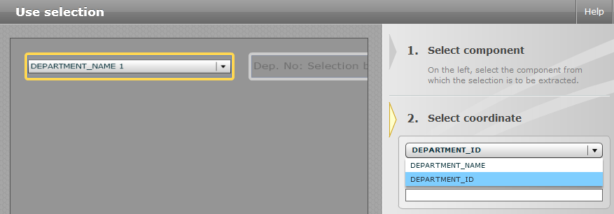
Use department’s name/number
Insert a label to echo user selections
Data assignment of label
Select Use selection option
Select the widget to echo the selection from
Select one of the two columns, i.e. attributes returned
In a similar way the department number will be used to query for employees

Slide 7
Use department’s name/number
Pass down selection
Data feeds can hold single value variables
User selections can be bound to variables – at runtime
Variable values can be sent to data sources
In this example the selected number will be used to compose a SQL statement at runtime
MashApp
Data feed
Fore ward variable
Database

Slide 8
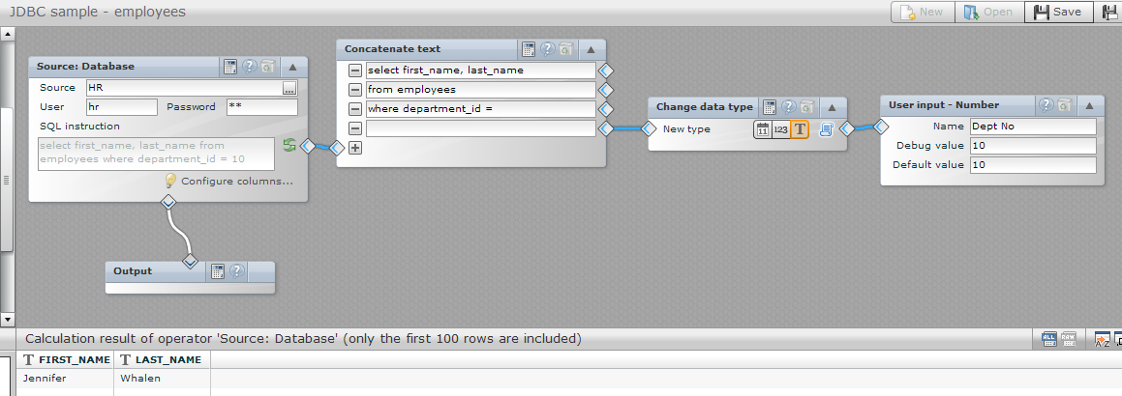
List employees filtered by department number
Use a table to list employees. The data feed behind it executes a query including a variable – department id:
select first_name, last_name
from employees
where department_id = X
Basically it’s a data source, text concatenation, number to string conversion and the user input on the far right hand side.

Slide 9
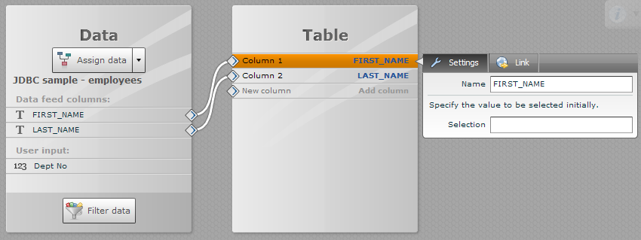
List employees filtered by department number
Data feeds including variables show them in data assignment mode below their columns

Slide 10
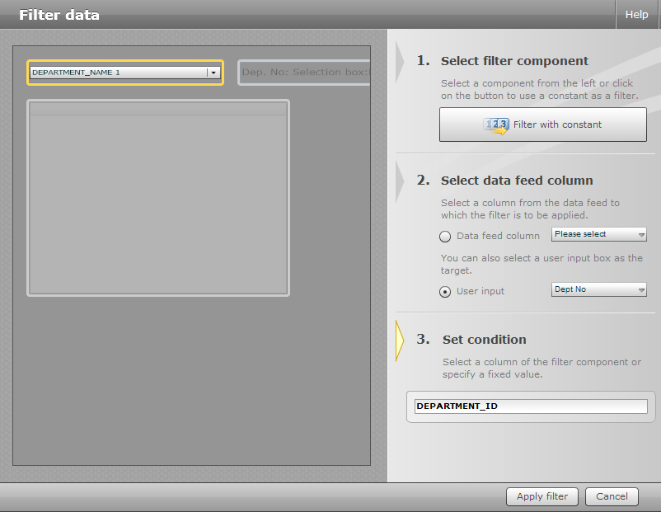
List employees filtered by department number
Binding user selections works almost like filtering
Select the department list and the id is selected automatically (since the only one of type number)

Slide 11
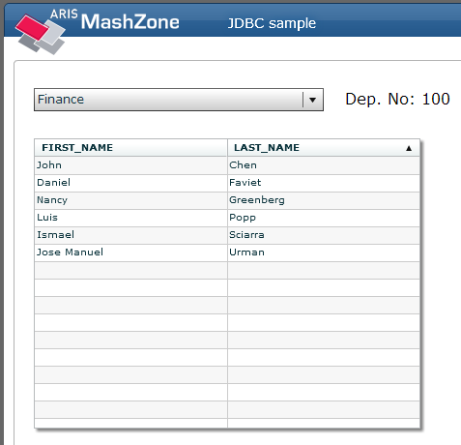
Done
Each box selection triggers another SQL query so filtering is handled by the back end.
The entire sample works with RESTful web services, PPM and Optimize almost identically!
MashApp read to be imported

Slide 12
Thank you!
MashZone Dynamic data sources

