Slide 1
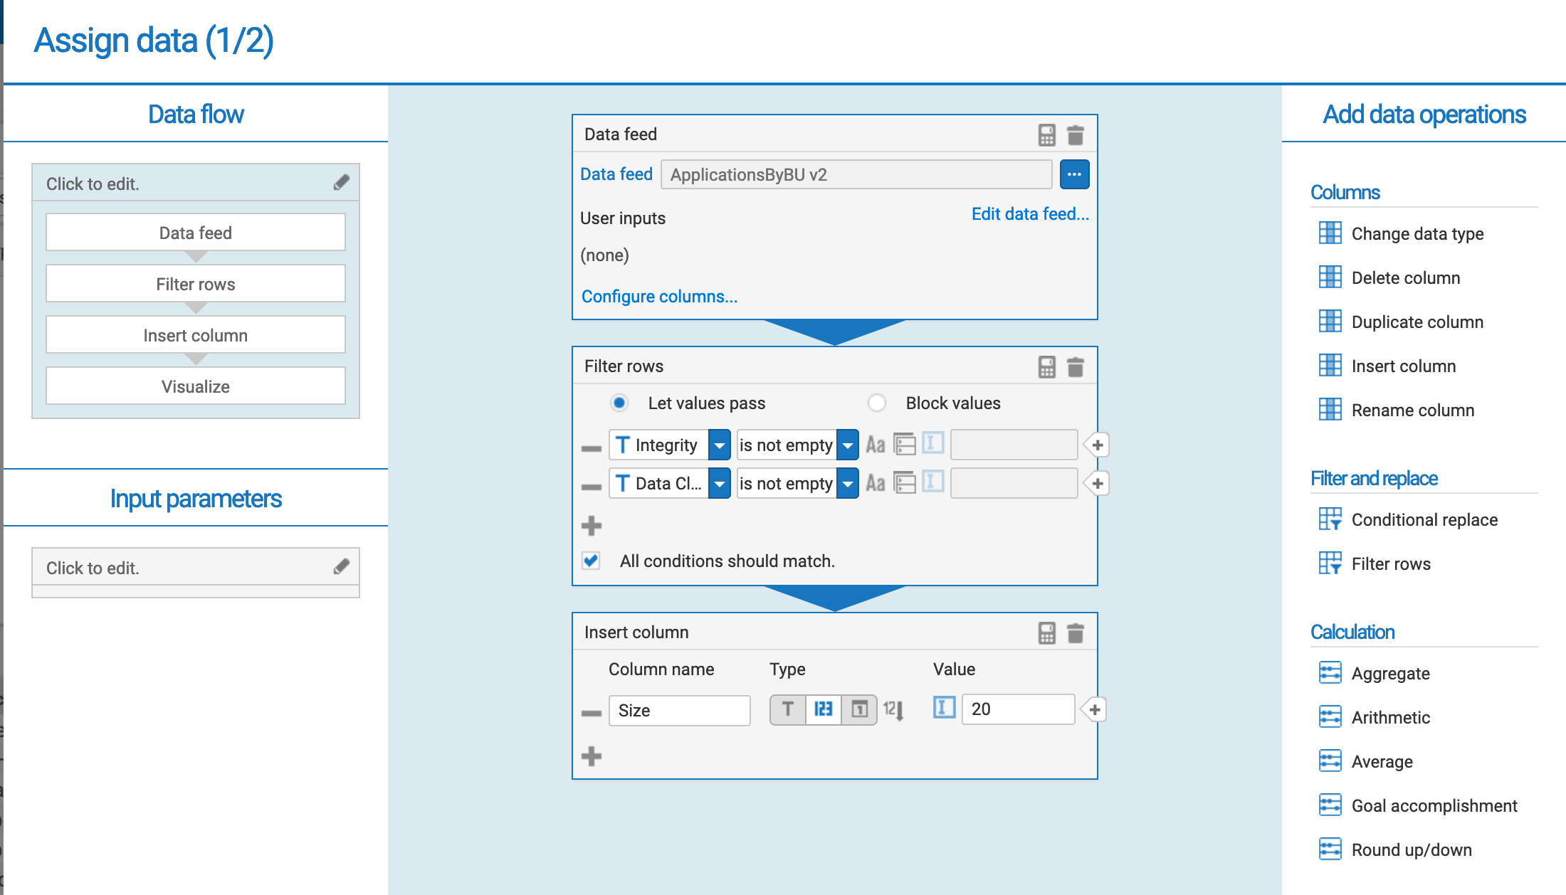

Slide 2
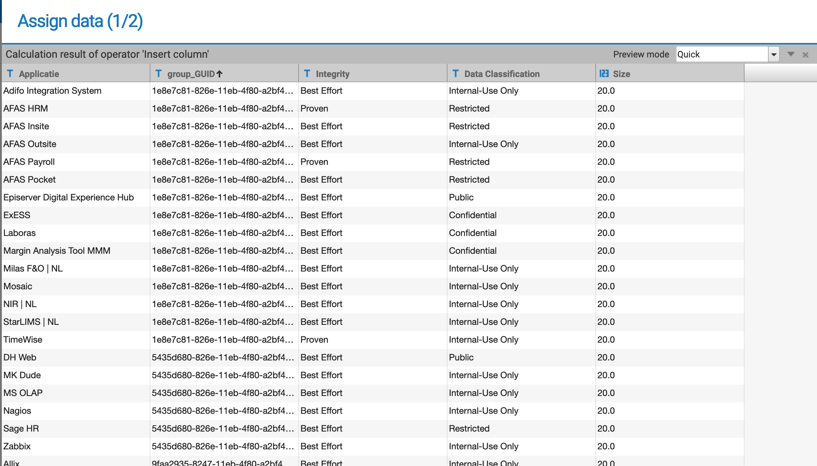
Size is a try-out to test if this affects the text size of the labels. (it doesn’t)

Slide 3
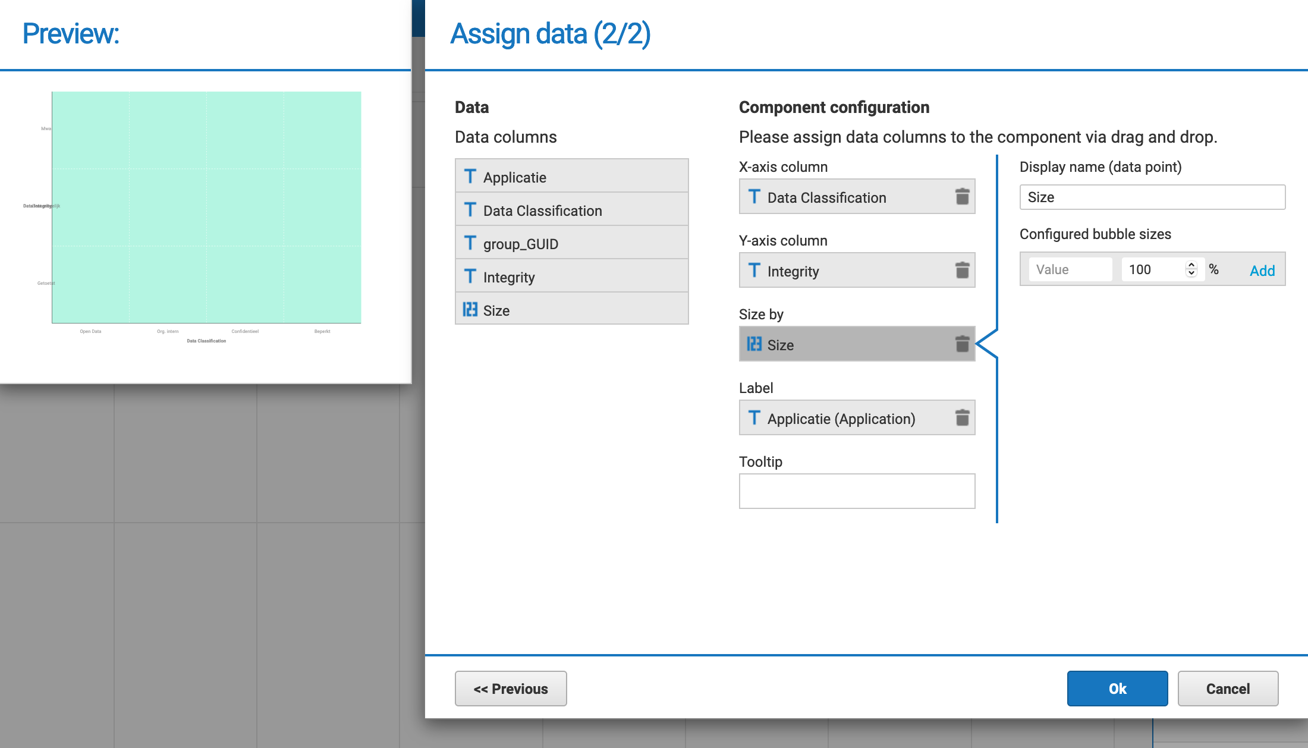
I expect something is shown here in the preview. Used some crappy colour for contast.
The final dashboard shows the same as preview.
Don’t understand what to do with Define levels: Help
Both axis show up in the preview, as configured: Great!
Labels don’t show up: Help
Don’t understand what to do with configured bubble sizes: Help

