Slide 1
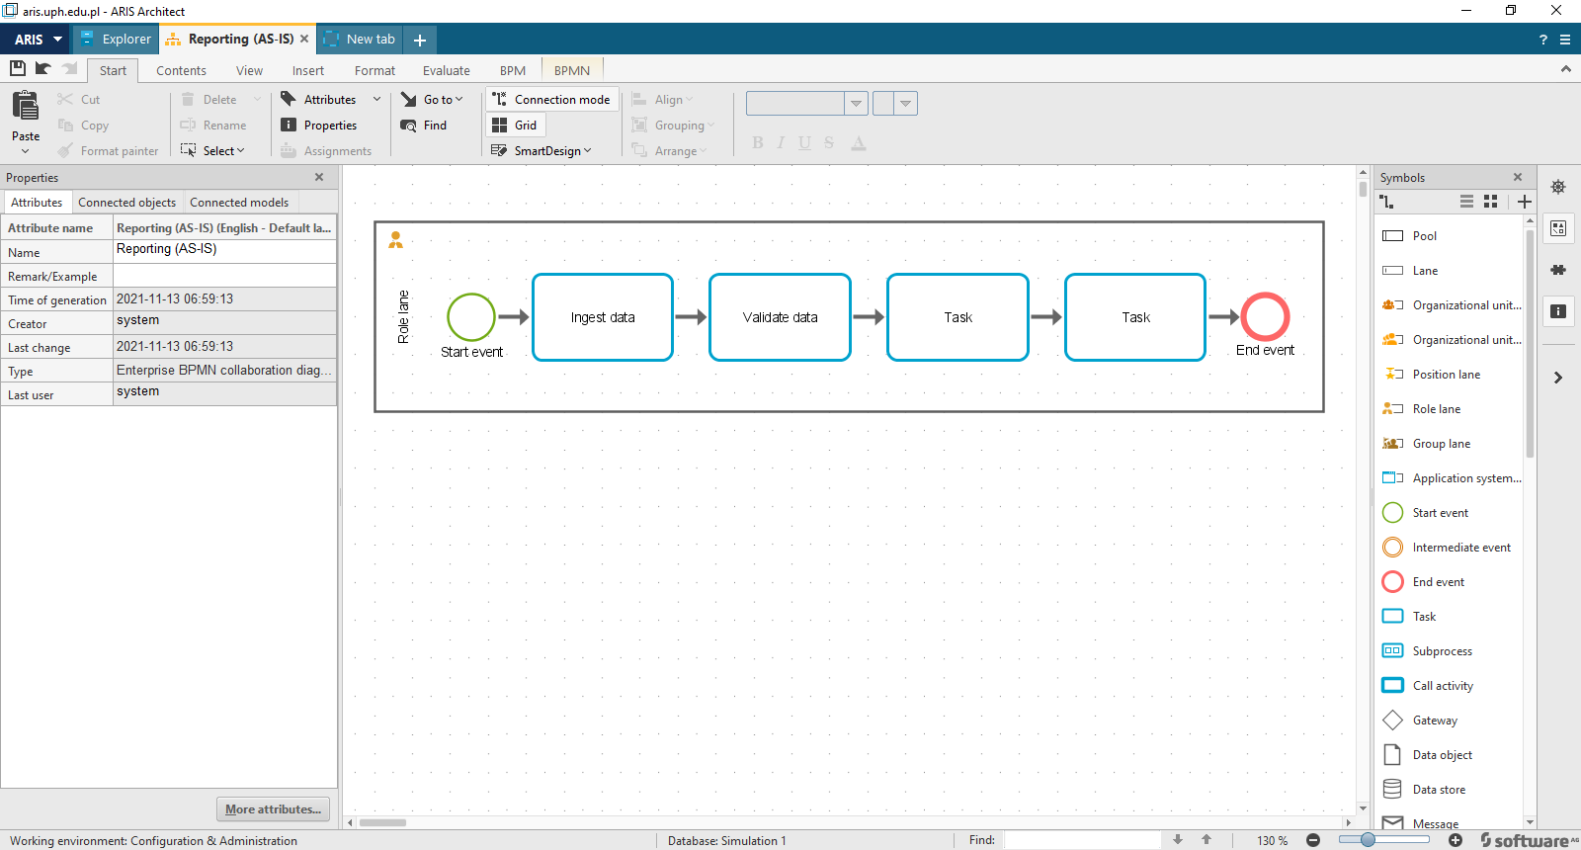
Step 1. Create Model - Enterprise BPMN collaboration diagram

Slide 2
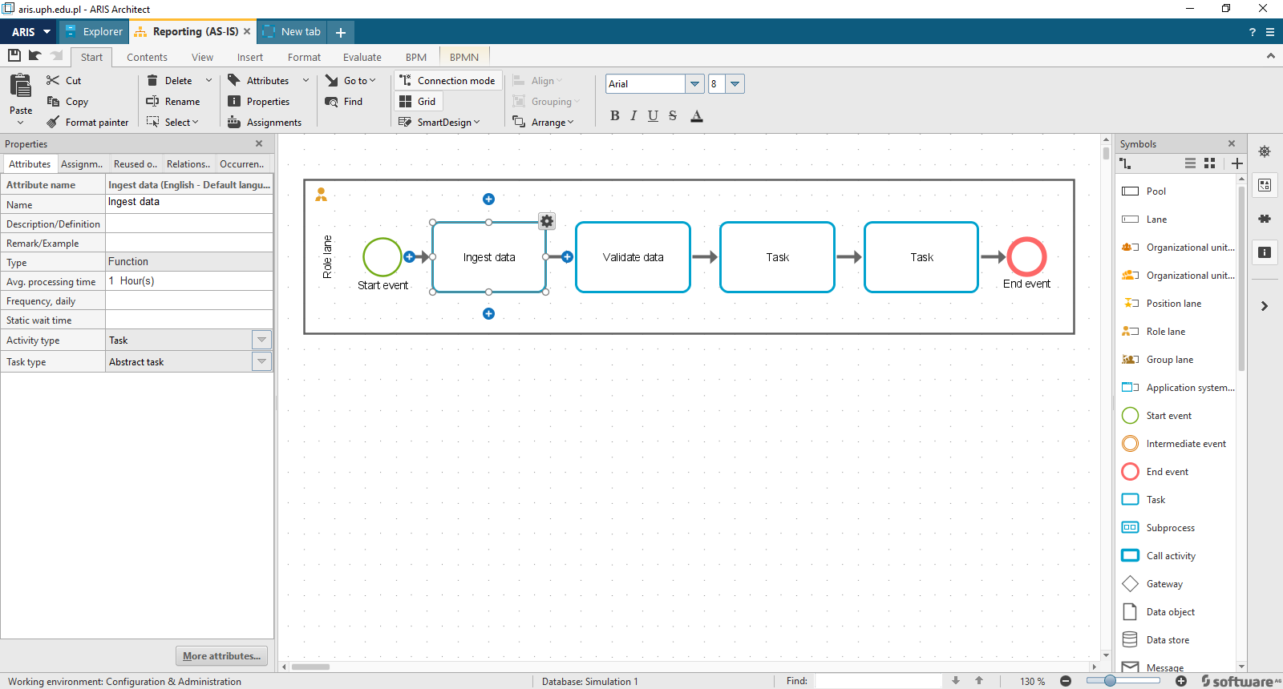
Step 2a. Assign Avrage Times (in Attributes)

Slide 3
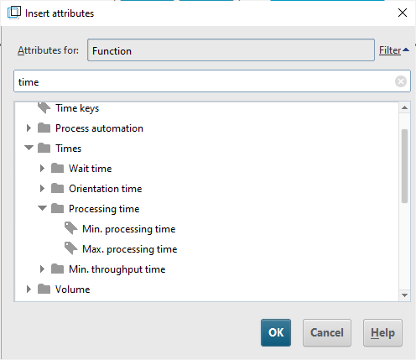
Step 2a. Assign Avrage Times (in Attributes)
Other options are available – using minimum or maximum time could be chosen; functions – constant, equal, normal log, normal distribution could create a more statistically relevant simulations.

Slide 4
Step 2b. Assign Avrage Times (in Attributes)

Slide 5
Step 2c. Assign Avrage Times (in Attributes)

Slide 6
Step 2d. Assign Avrage Times (in Attributes)

Slide 7
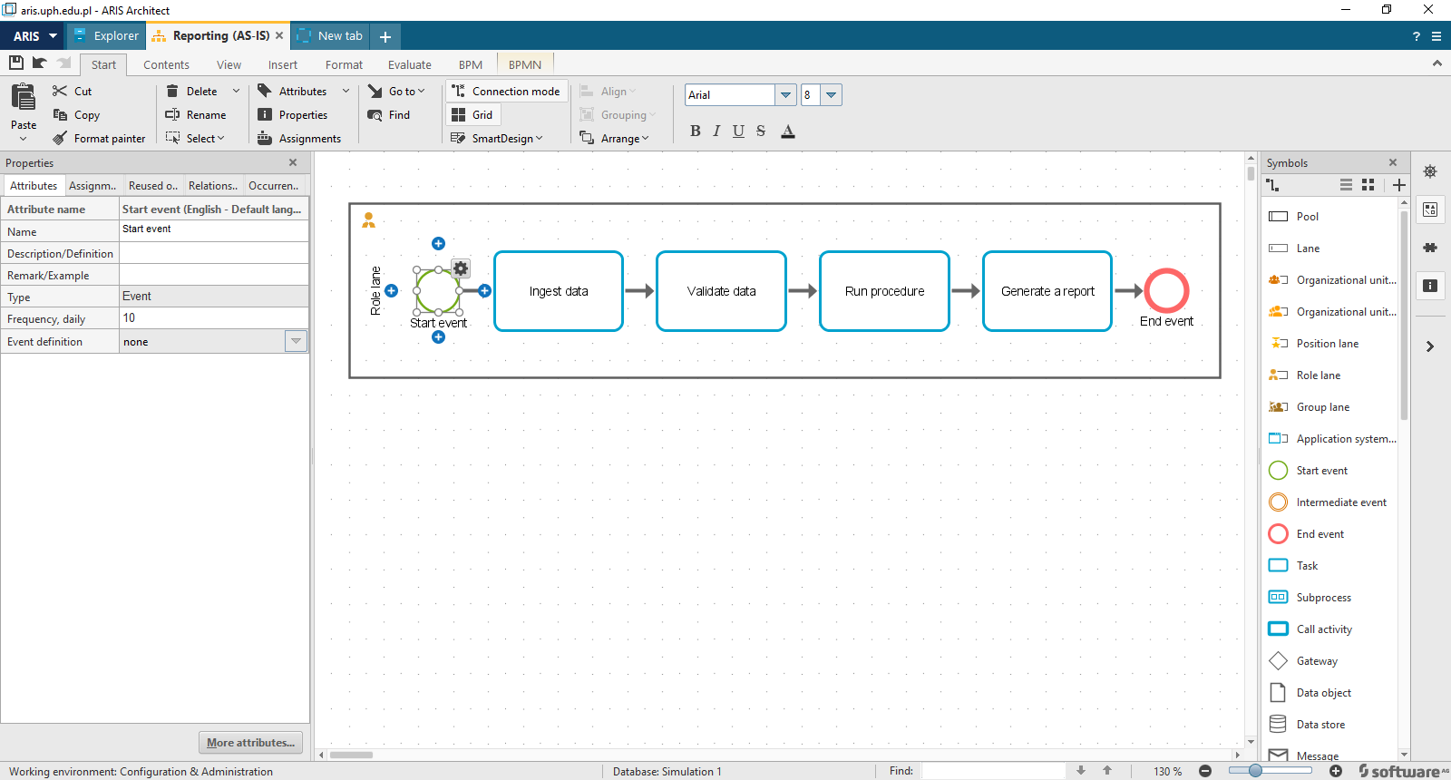
Step 3. At the start event add frequency daily

Slide 8
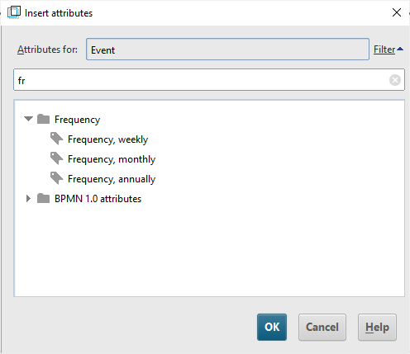
Step 3a. At the start event add frequency daily
Other options are available

Slide 9
Step 3a. At the start event add frequency daily
Other options are available

Slide 10
Step 4. Input costs per human resources

Slide 11
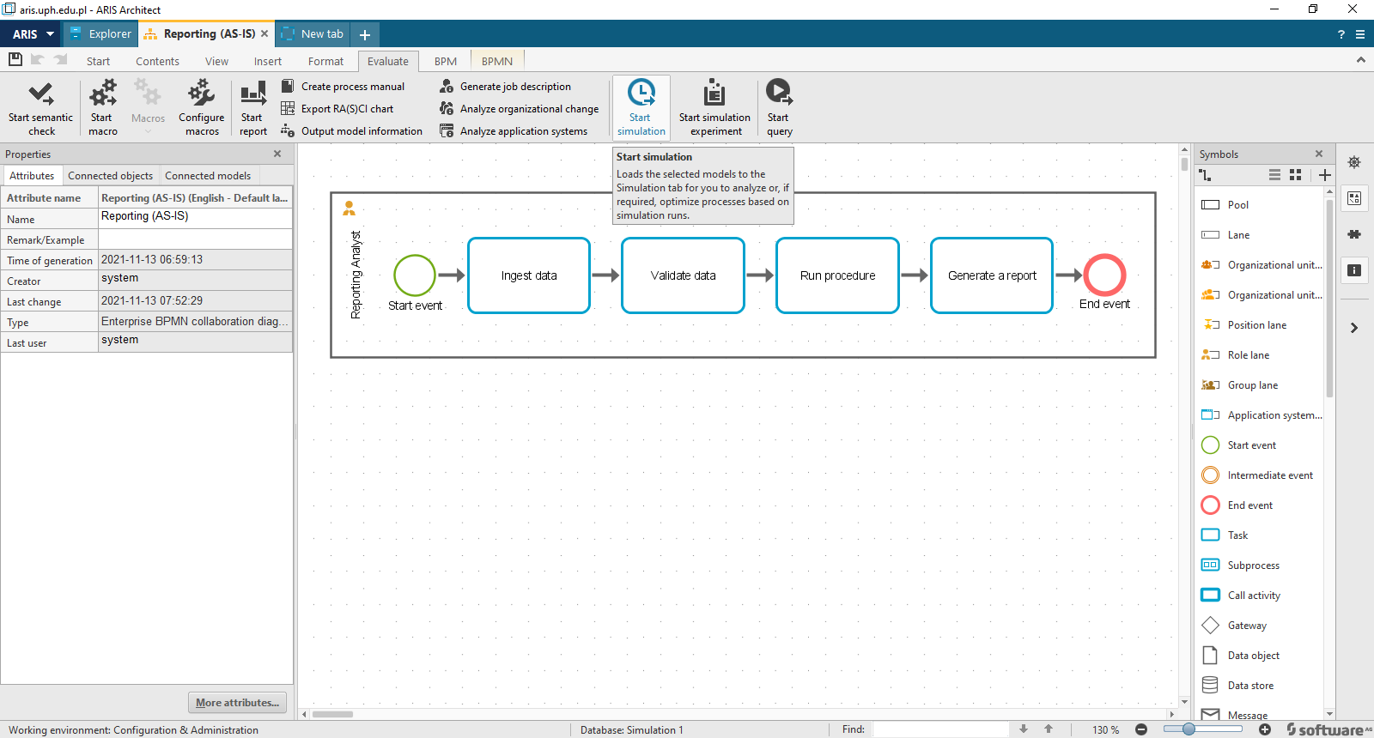
Step 5. Evaluates and start simulation

Slide 12
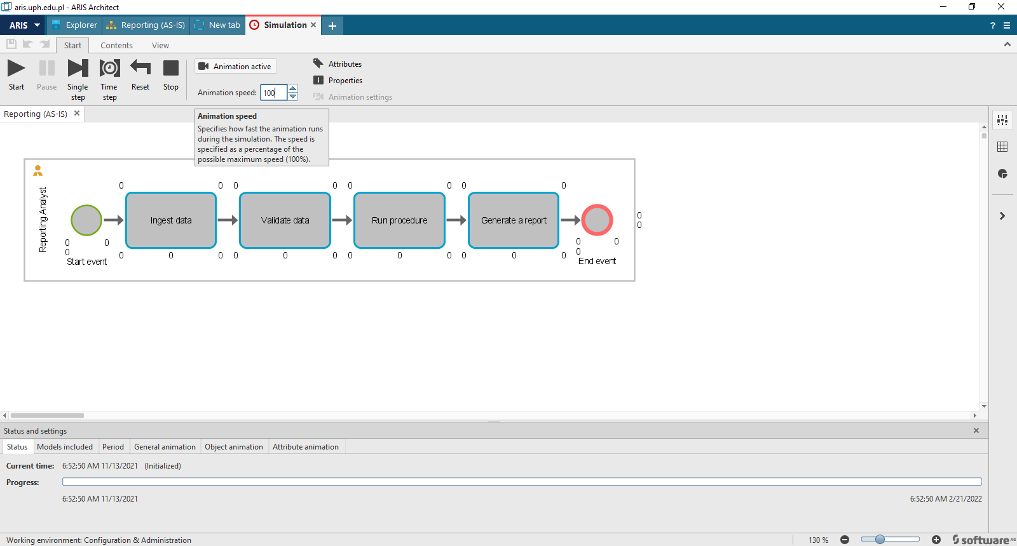
Step 6. Adjust the animation speed

Slide 13
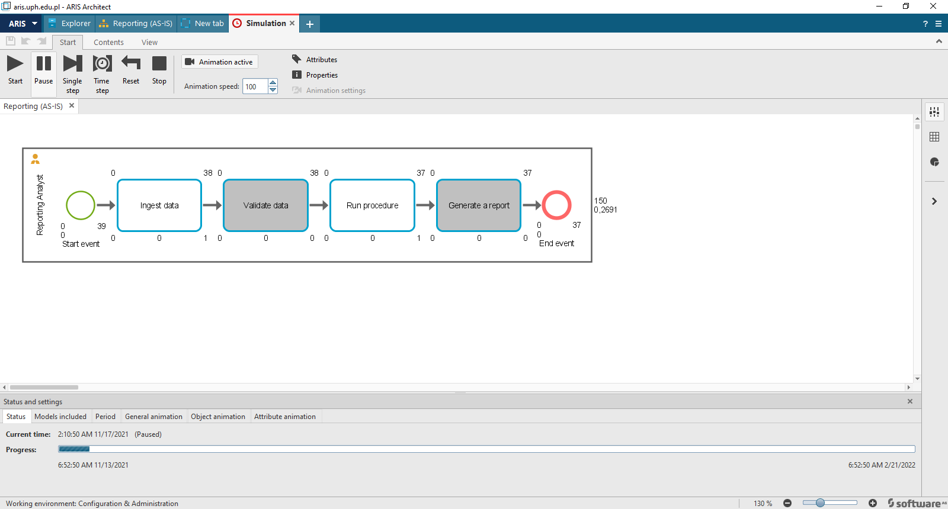
Step 7. Start the simulation
degree of activation so there's 73%
that's the utilization of the person
that's involved and the number of
activities a per Dave process or number
of times that they process an activity
Different values than from the movie –degree of activation - hy?https://youtu.be/VBCmZX4oXiE?t=275

Slide 14
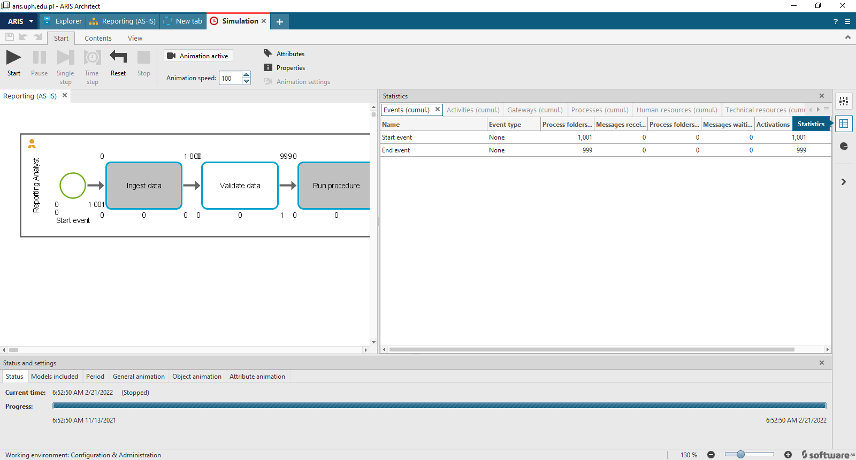
Step 8. Statistics

Slide 15
Step 8. Statistics

